Slide 1
Big Data in Astronomy: Hands on with Large Surveys
AST 497 A
mjuric@astro.washington.edu

Slide 2
Today
Administrivia
Introduction to Large Surveys

Slide 3
About Me
Mario Juric (mar-ee-oh you-rich)
What I do:
Science derived from large surveys: Galactic structure, properties of the solar system
Astronomical algorithms and software research
Optical astronomer (=> some bias towards optical surveys)
Hats I wear
Professor @ Astronomy
Sr. Fellow @ UW’s eScience Institute
Data Management Project Scientist @ LSST

Slide 4
About Me
Nominal Coordinates:
Office: C320
E-mail: mjuric@astro.washington.edu

Slide 5
About This Course
The goal of this course is to prepare you for research with large survey data, teach you how to think about such data sets, and give you an overview of what is or soon will be available.
We will:
Learn about how large observational data sets are changing astronomy
Introduce tools and techniques for working with large data sets (incl. access, analysis, and visualization)
Introduce and work hands-on with existing data sets (including SDSS, WISE, Kepler and others)
Learn about major upcoming surveys (including PanSTARRS, Gaia, and LSST)

Slide 6
Learning about Learning
In survey astronomy (and related computing disciplines), things change too quickly to be learned only once – it’s a process that never ends.
The major emphasis of this course will be on showing how to independently find information, evaluate, and use it.

Slide 7
Mailing List
astr497a_sp15@uw.edu
Some of you may be auditing
If you’re not enrolled, e-mail me your e-mail address so I can add you to the class mailing list
mjuric@astro.washington.edu
All announcements, etc., will go via that list

Slide 8
Lectures
MF, 11am-12:20pm
Mondays: Lecture
Fridays: Hands-on work
May deviate from this pattern early on
Lecture structure:
About an ~hour for introducing new materials, etc.
Leave ~20 minutes for open-ended discussion
Interrupt and ask questions at any time!

Slide 9
Course Materials
I’ll be adding most of what we need to the following repository on GitHub:
https://github.com/mjuric/ast497a

Slide 10
Smile, You’re On Camera!
Actually, it’s mostly me who’s on camera…
Actually, it’s mostly my slides that will be on camera…
Viewing the recording later, via YouTube
I’ll e-mail the link after class
Note: recorded classess will be private, and won’t be kept after this quarter ends.

Slide 11
Syllabus
https://github.com/mjuric/ast597b
Still being finalized
Three parts
Software / Data Analysis Tools (~ April)
Major Surveys (~ May)
Future Surveys and Data Challenges (~June)

Slide 12
Grading, Homeworks, Etc.
Two homeworks (50% of the grade):
All homeworks will be IPython notebooks, turned in via GitHub
HW #1, due end of April, focused on software tools
HW #2, due end of May, focused on survey data analysis
Paper presentations (25% of the grade):
Present a paper on a survey / dataset of your choosing, making sure to cover:
The goals of the survey
The data it contains (and any caveats about it)
What it may be useful for
The best ways to obtain it
Final project (25% of the grade):
More about this in a week or so ☺.

Slide 13
Questions?

Slide 14
Large Survey and Why They’re Different

Slide 15
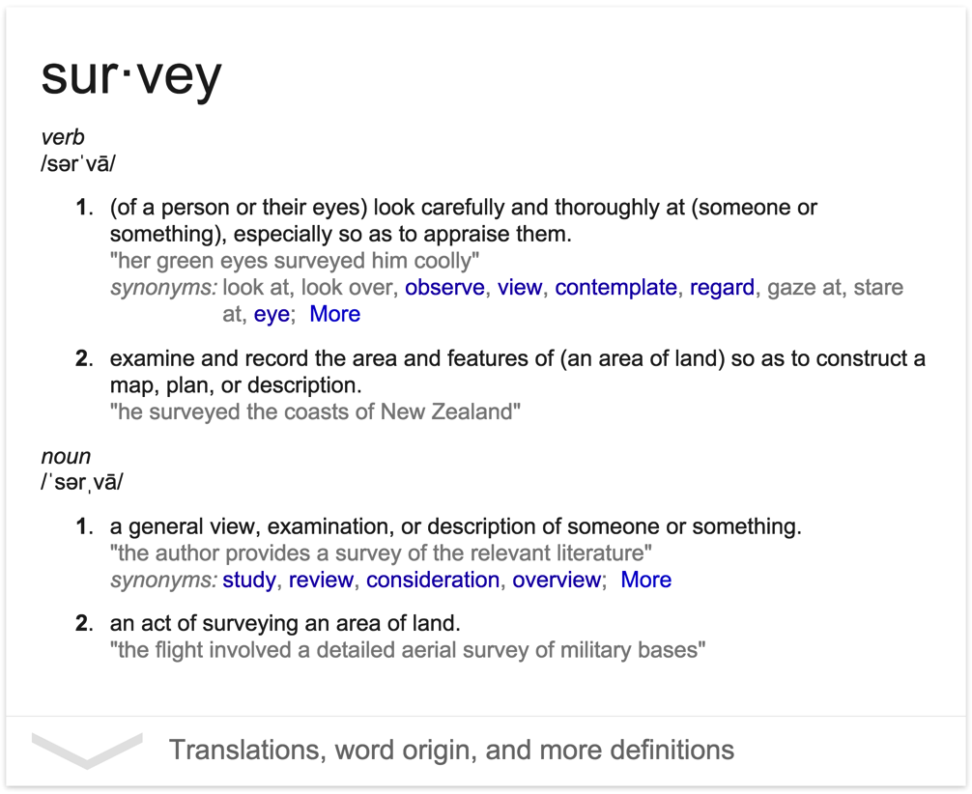

Slide 16
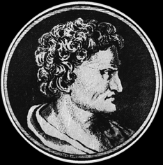
Hipparchus of Rhodes (180-125 BC)
Discovered the precession of the equinoxes.
Measured the length of the year to ~6 minutes.
In 129 BC, constructed one of the first star catalogs*, containing about 850 stars.
n.b.: also the one to blame for the magnitude system …

Slide 17
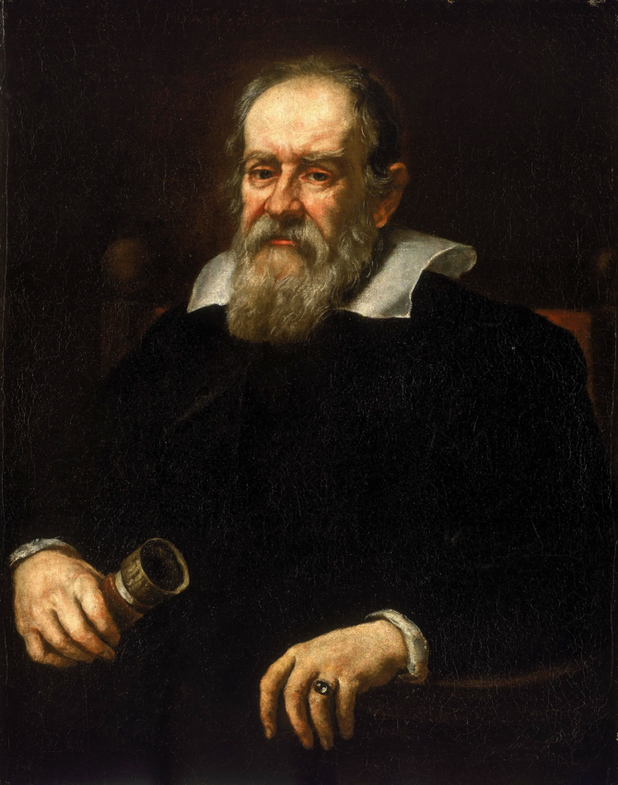
Galileo Galilei (1564-1642)
Researched a variety of topics in physics, but called out here for the introduction of the Galilean telescope.
Galileo’s telescope allowed us for the first time to zoom in on the cosmos, and study the individual objects in great detail.

Slide 18
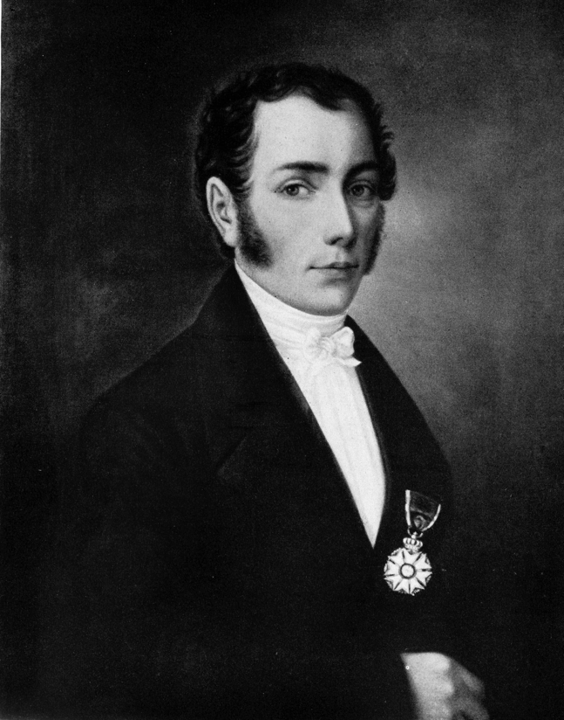
Joseph von Fraunhofer (1787-1826)
Mounted a prism in front of an objective of a small telescope, and pointed it to the Sun.
In 1859, Kirchhoff and Bunsen understood what Fraunhofer saw.
The birth of modern astrophysics!

Slide 19
The Astrophysics Two-Step
Surveys
Construct catalogs and maps of objects in the sky. Focus on coarse classification and discovering targets for further follow-up.
Large telescopes
Acquire detailed observations of a few representative objects. Understand the details of astrophysical processes that govern them, and extrapolate that understanding to the entire class.

Slide 20
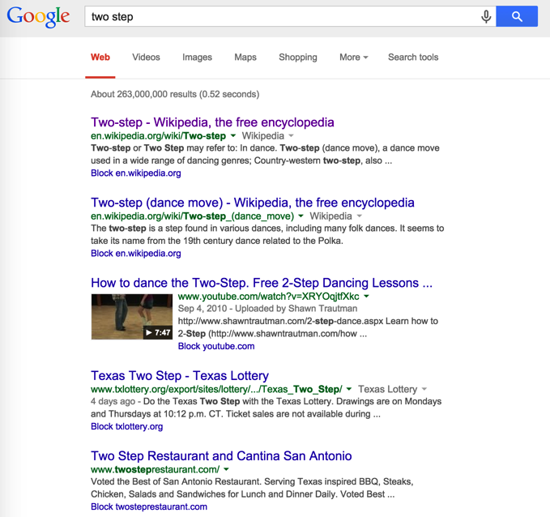
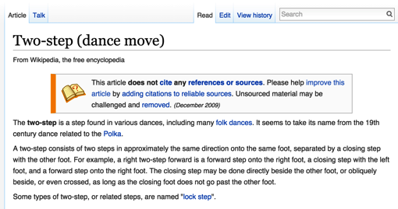
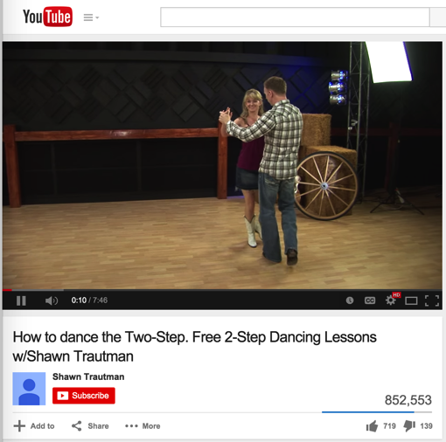
Analogy: Google Search
Google’s index is a catalog of the Web. We use it to “zoom in” on individual entries to find out more.

Slide 21
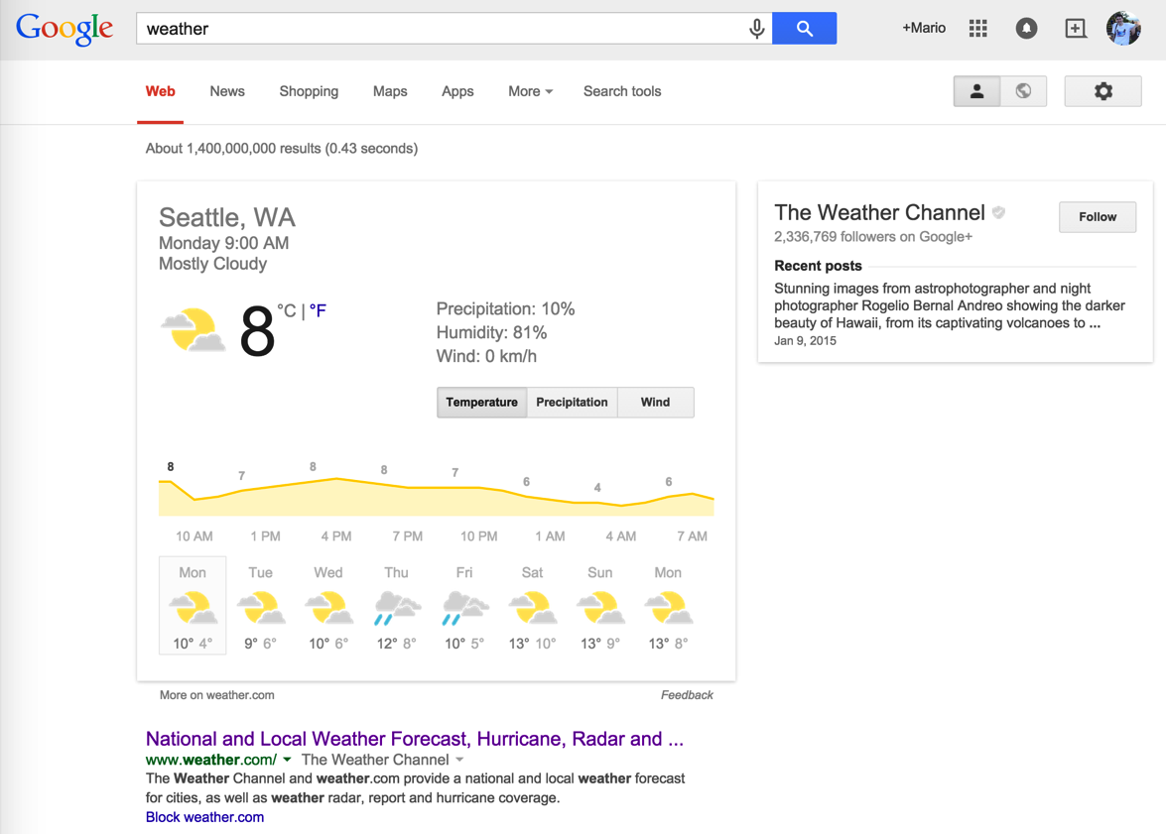
But, it’s more than just a catalog of pointers – more and more, Google itself collects, processes, indexes, visualizes, and serves the actual information we need.
More and more often, our “research” begins and ends with Google!

Slide 22
Modern Large Astronomical Surveys are the Googles of the Sky
There’s a close parallel with large surveys in astronomy, in scale, quality, and richness of the collected information
Scale: We’re entering the era when we can catalog the entire sky
Quality: Those catalogs will be as precise as the measurements taken with “pointed” observations (used to be ~5-10x worse)
Richness: Those catalogs contain not only positions and magnitudes, but also shapes, profiles, and temporal behavior of the objects.
Quite often, the research begins and ends with the survey.
This is what makes large surveys of today not just bigger, but different. They’re more than just “finding charts”.

Slide 23
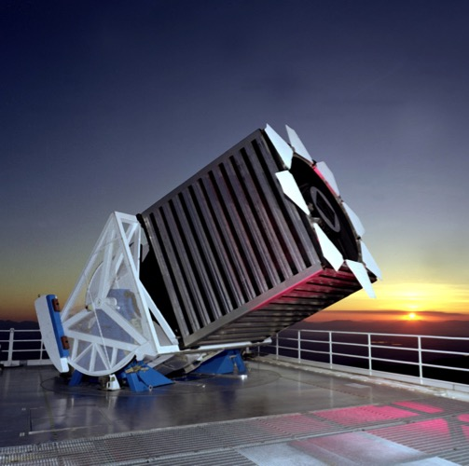
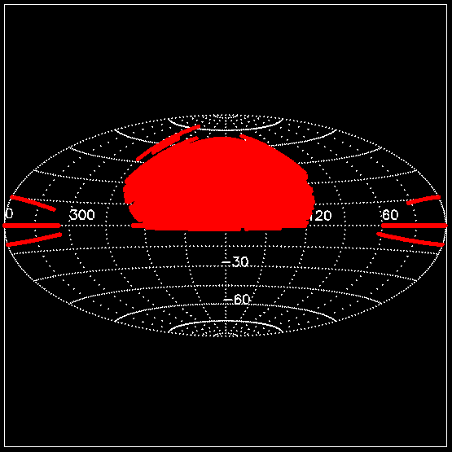
Sloan Digital Sky Survey
2.5m telescope 10000 deg² 0.1” astrometry r<22.5 flux limit
5 band, 2%, photometry for >50M stars, >280k R=2000 stellar spectra
SDSS DR6 Imaging Sky Coverage (Adelman-McCarthy et al. 2008)

Slide 24
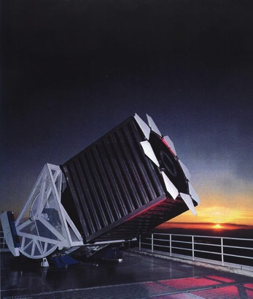
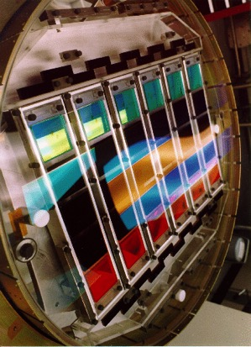
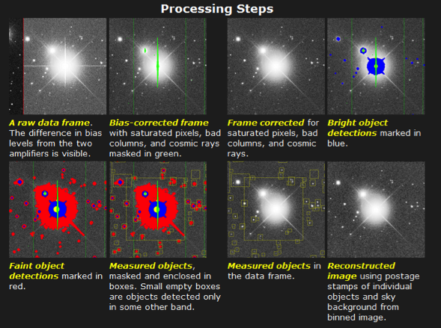
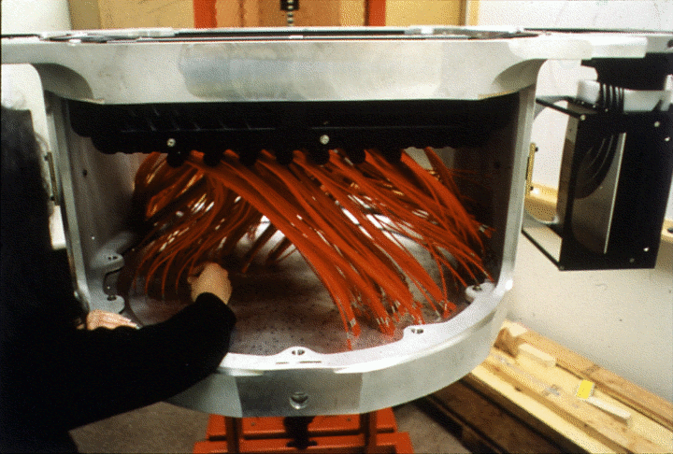
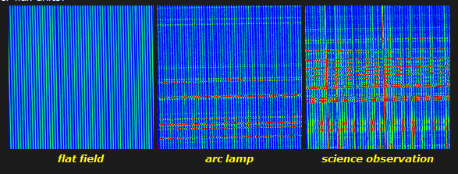
Observing With SDSS

Slide 25
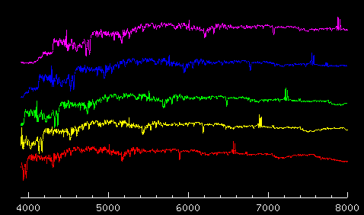
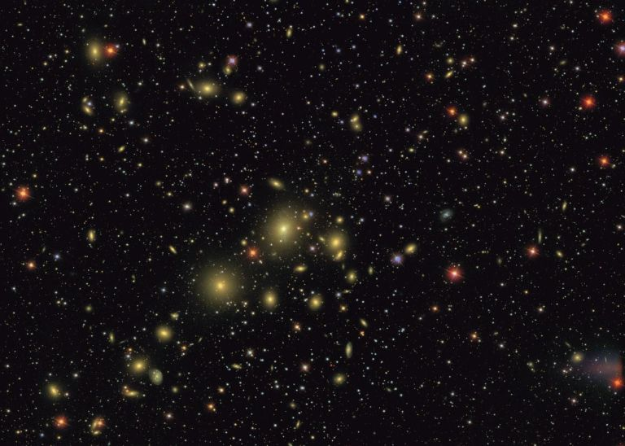
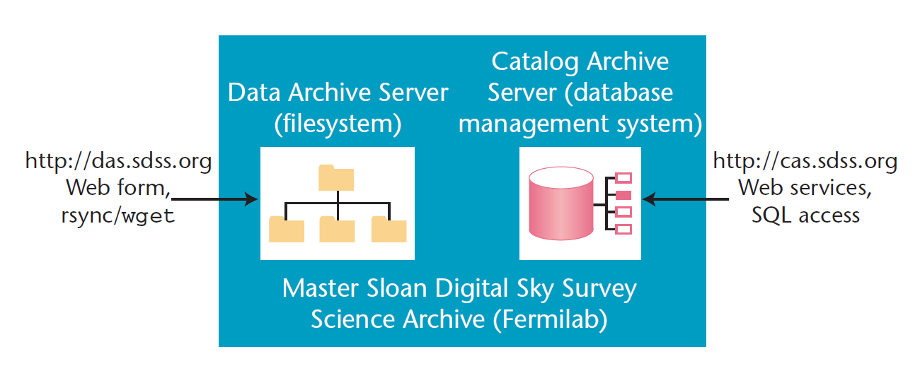

Slide 26
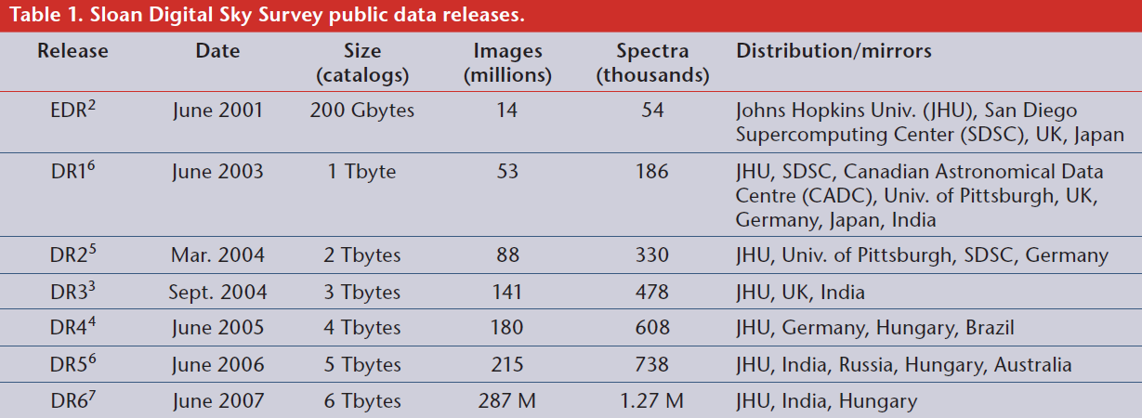
Thakar (2006)

Slide 27
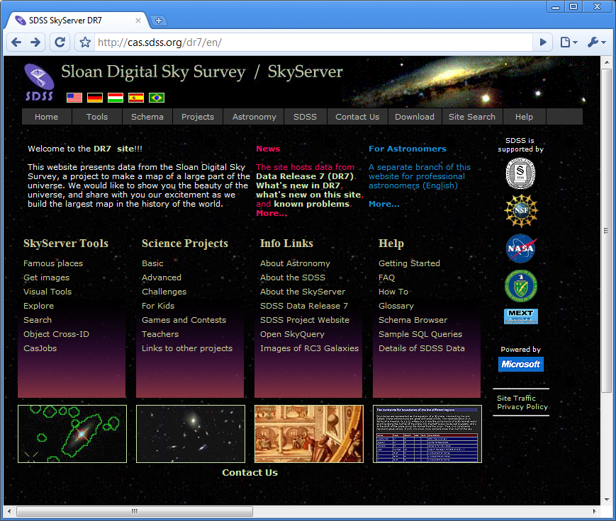

Slide 28
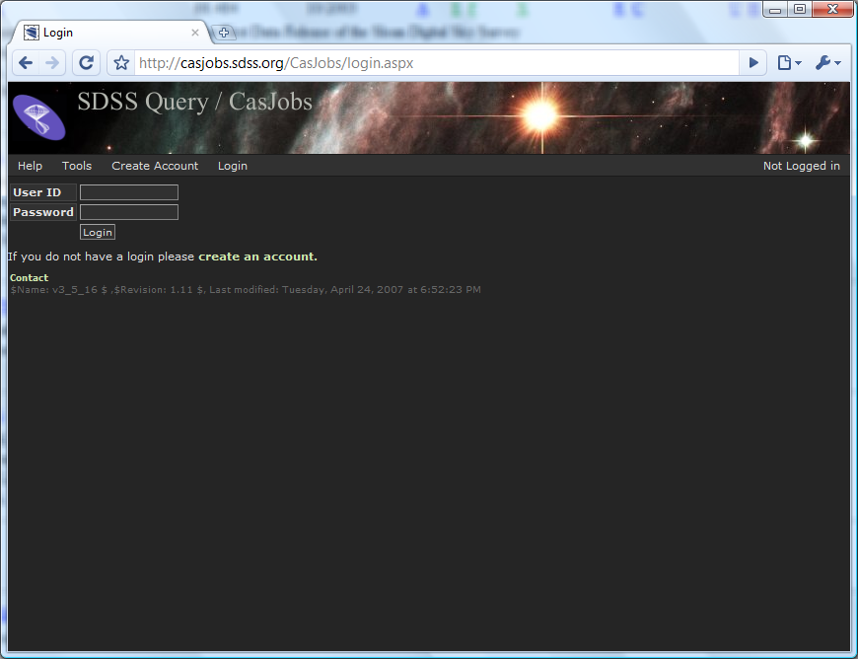
CasJobs: Running long and complex queries

Slide 29
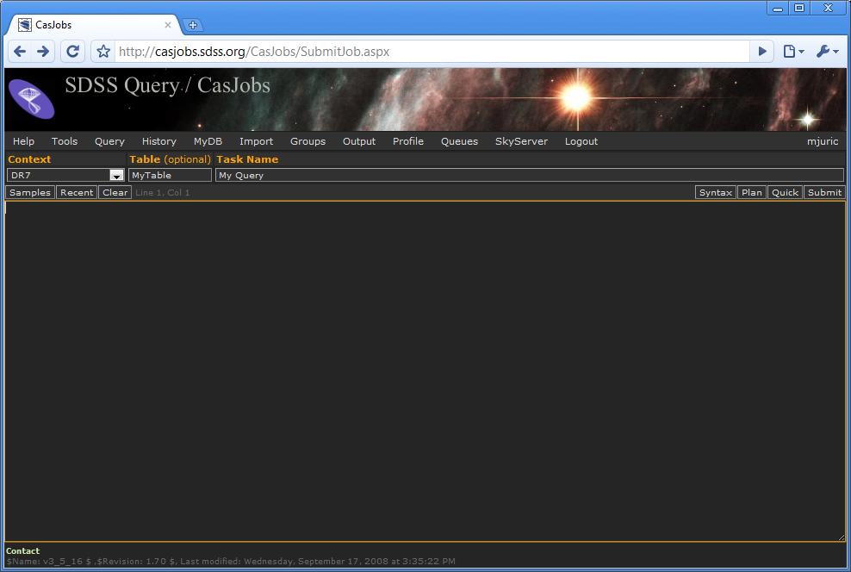
SDSS CasJobs Service

Slide 30
Example: Get the positions (in Galactic coordinates) and dereddened magnitudes of all stars within 1 degree of α = 341.6, δ = 31.7

Slide 31
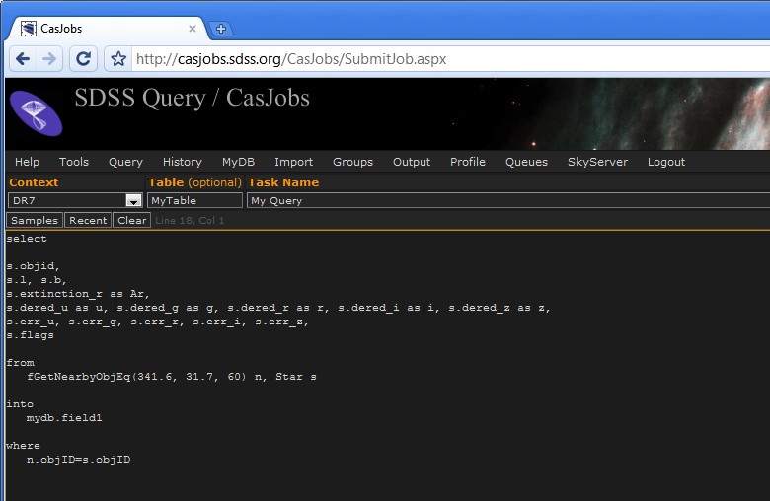
An SQL Query
SQL – Structured Query Language
A language for specifying and extracting subsets of data from large tabular databases.
Allows you to select only the data that satisfy a certain set of (possibly very complicated) restrictions that you specify

Slide 32
Anatomy of an SQL Query
SELECT – select a subset of entries from the catalog, based on the criteria we will specify
Columns – the columns we are interested in. Usually we don’t want all (> 50!) available columns, but just some (e.g., id, position, extinction, magnitudes, errors, and flags)
FROM clause – the tables from which to fetch the columns above. Can be “virtual”.
INTO clause – where to store the result. The results go to tables in your personal database.
WHERE clause – the filter with which to filter the result.

Slide 33
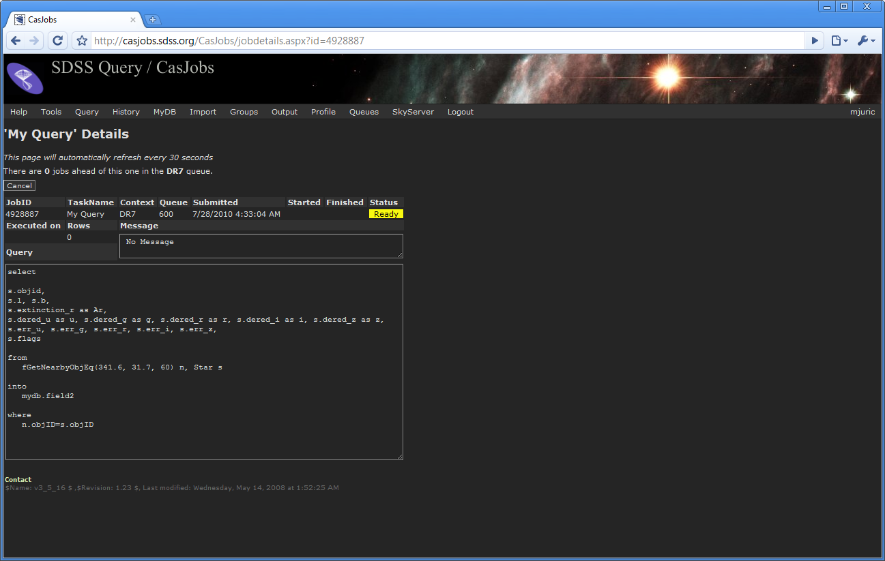
Submitted Job

Slide 34
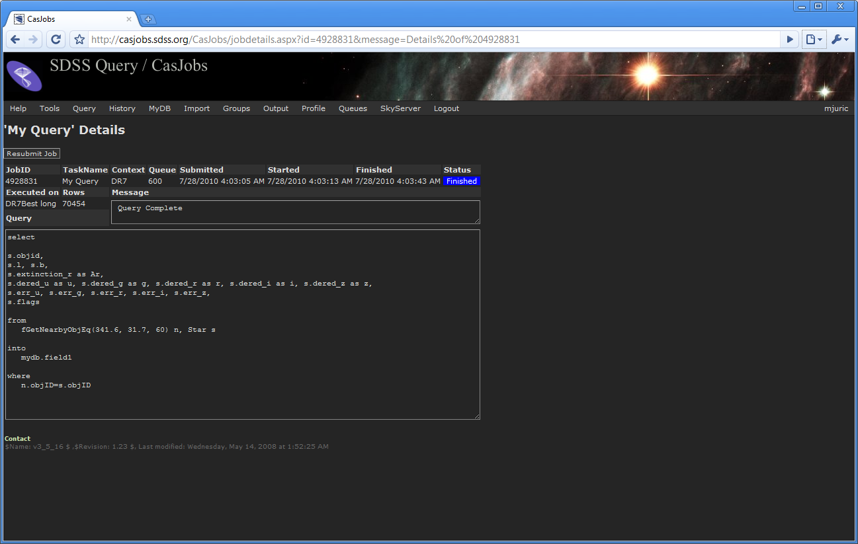
Completed Job

Slide 35
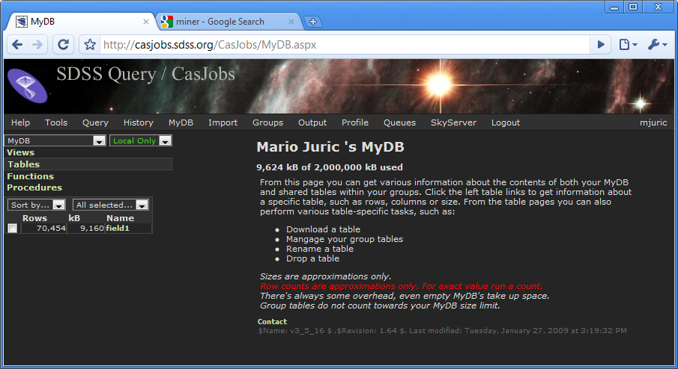

Slide 36
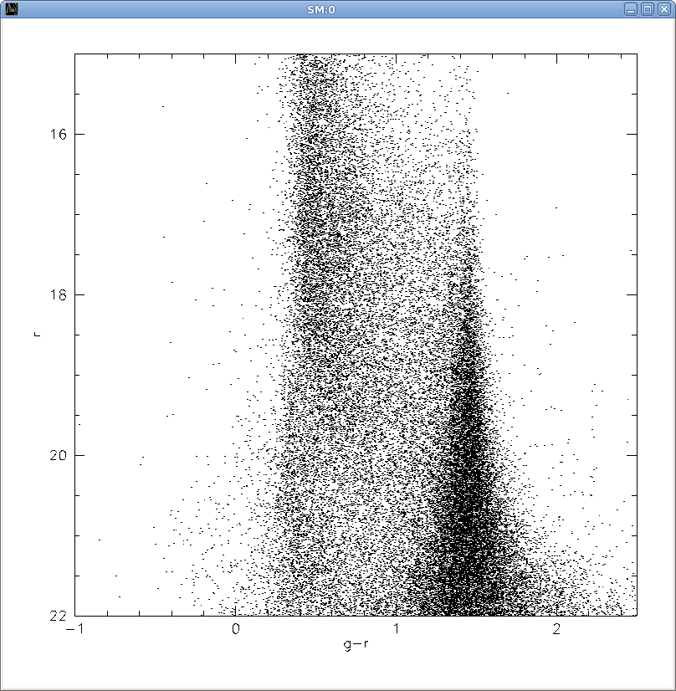
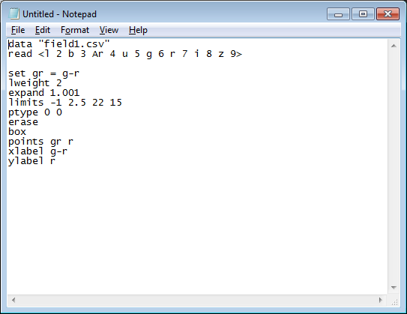
Basic Data Analysis: A Color-Magnitude Diagram (CMD)

Slide 37
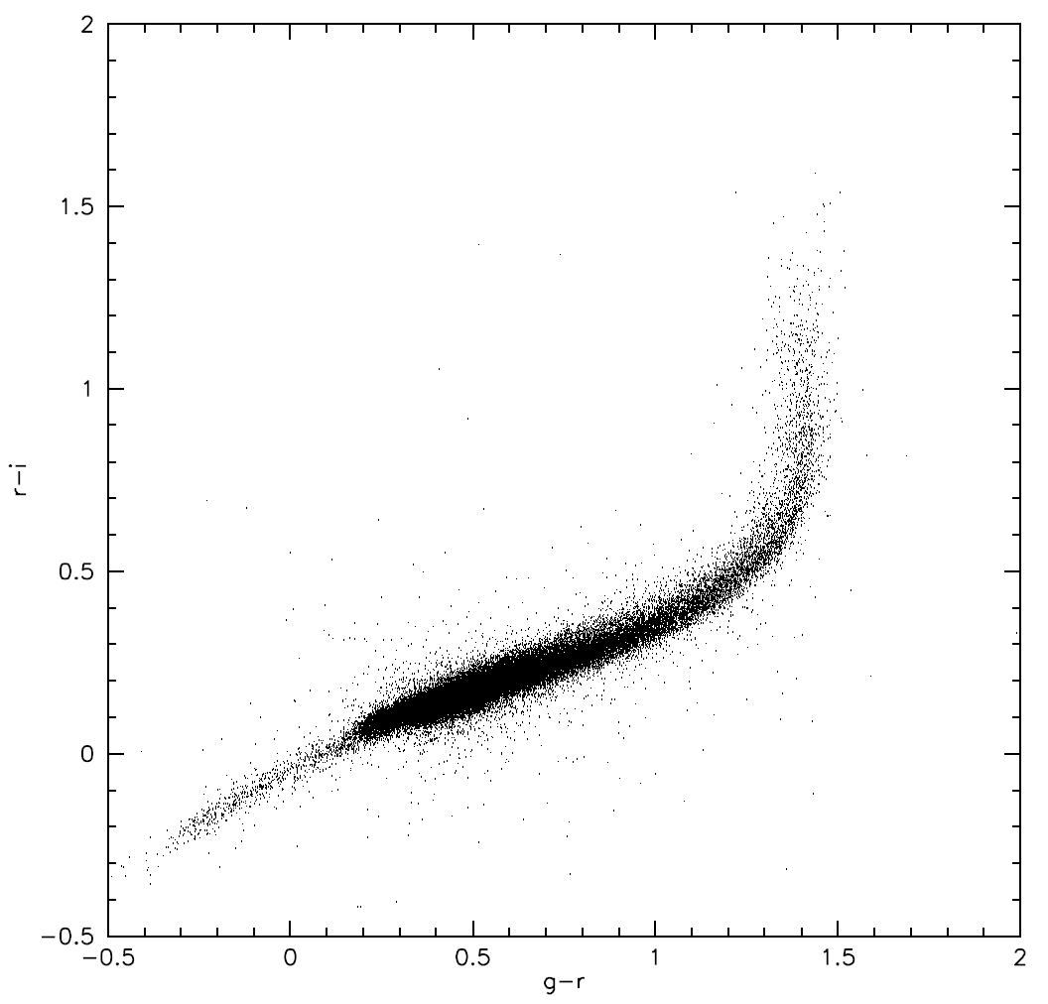
Interpreting Stellar CMDs
M
K
F
G
HB
F stars
M stars
More Luminous
Less Luminous

Slide 38
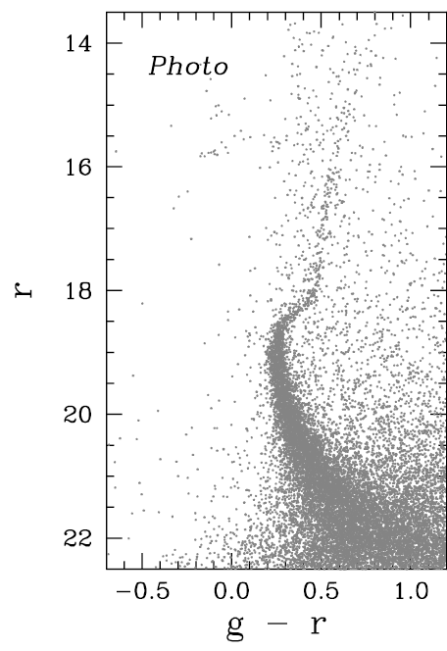
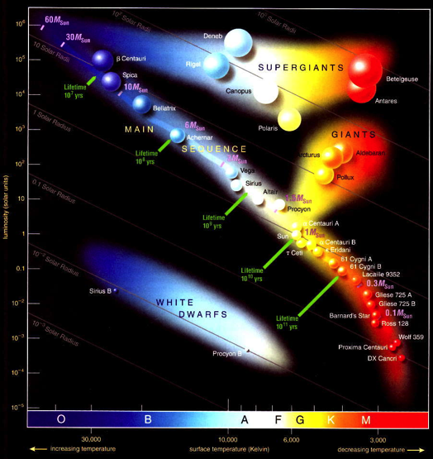
A CMD of a Globular Cluster
M3
A globular cluster is a simple population (same age, same metallicity), at the same distance.

Slide 39

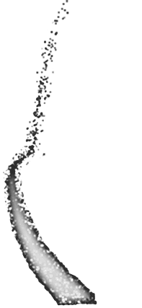
Interpreting “Field” CMDs
Closer
Farther

Slide 40
Interpreting “Field” CMDs
Closer
Farther
What about the giants? Yes, they are there, but significantly less numerous (<5%) than the main sequence stars. The same applies for early type stars, white dwarfs, etc.

Slide 41

Basic Data Analysis: A Color-Magnitude Diagram
Disk G/F stars
Closer
Nearby Disk K/M stars
Halo stars
Farther
QSOs, RRLyrae, WDs, errors…
F stars
M stars
More Luminous
Less Luminous

Slide 42
Get the positions (in Galactic coordinates) and dereddened magnitudes of all stars within 1 degree of α = 341.6, δ = 31.7
α = 115.2, δ = 32.7

Slide 43
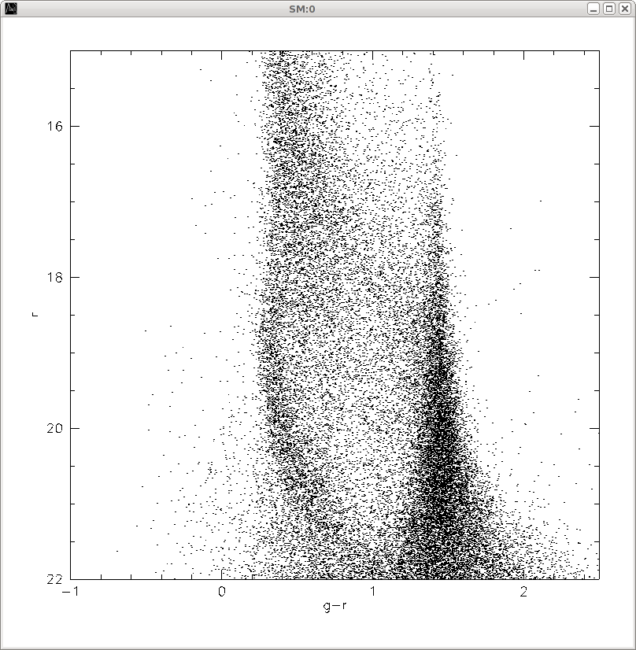

Color-Magnitude Diagram

Slide 44
Color-Magnitude Diagram
Disk G/F stars
Nearby Disk K/M stars
Halo stars
QSOs, RRLyrae, WDs, errors…

Slide 45
Notice Anything Different…?
Field #1
Field #2

Slide 46
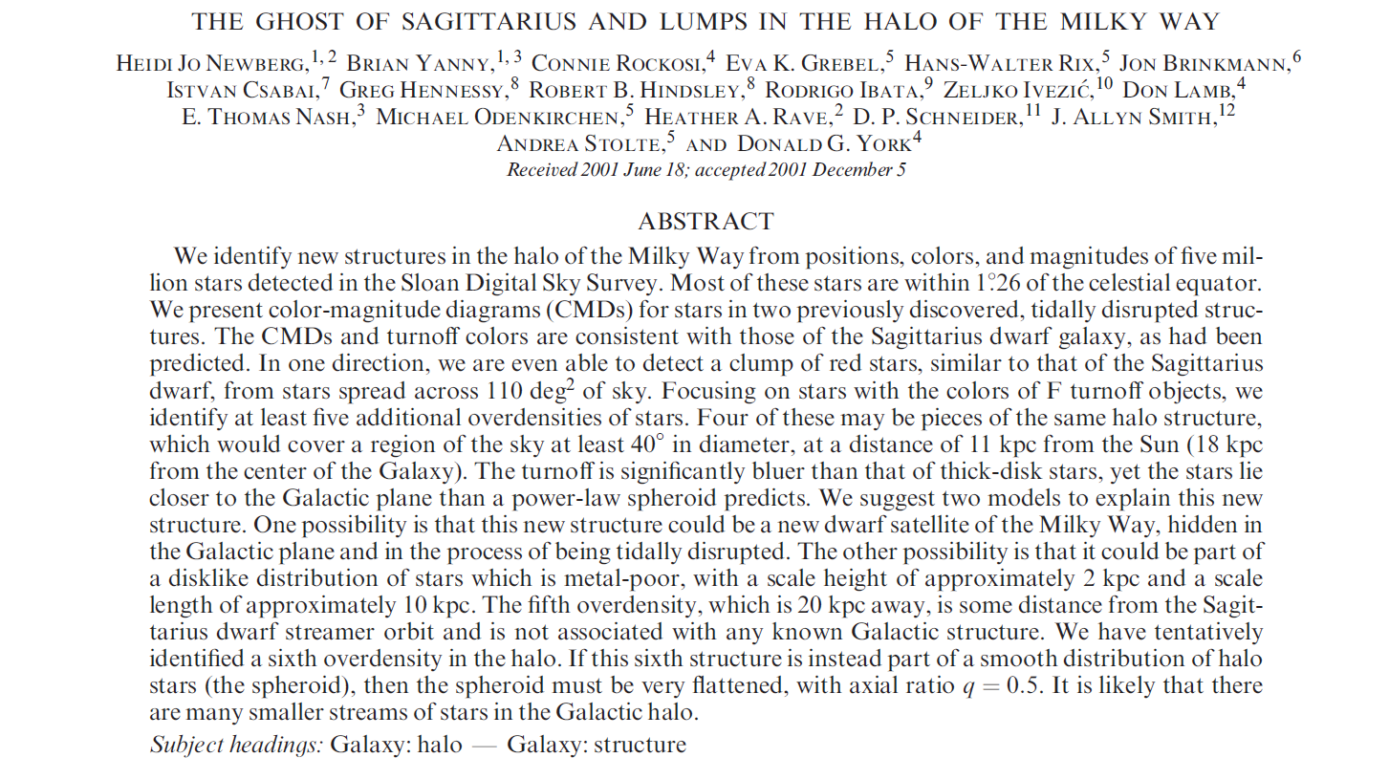
Monoceros Stream (Newberg et al. 2002)

Slide 47
Learning about structures from CMDs
Monoceros stream CMD
Globular cluster M3
(An et al. 2008)
⇨ Monoceros stream is a localized structure

Slide 48
Learning about structures from CMDs
Monoceros stream CMD
⇨ The distance to the Monoceros stream has to be around ~11.5kpc
18.8

Slide 49
Learning about structures from CMDs
Monoceros stream CMD
Turn-off color of the Monoceros stream is bluer than that of the disk
⇨ Mon. stars are either more metal poor, or younger than disk stars

Slide 50
Monoceros Stream (Newberg et al. 2002)

Slide 51
Hmmm… How do I do this for the whole sky?
Monoceros stream CMD

Slide 52
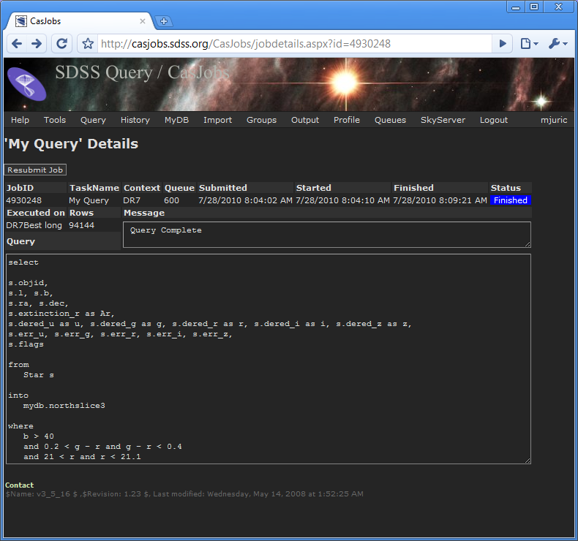

Slide 53
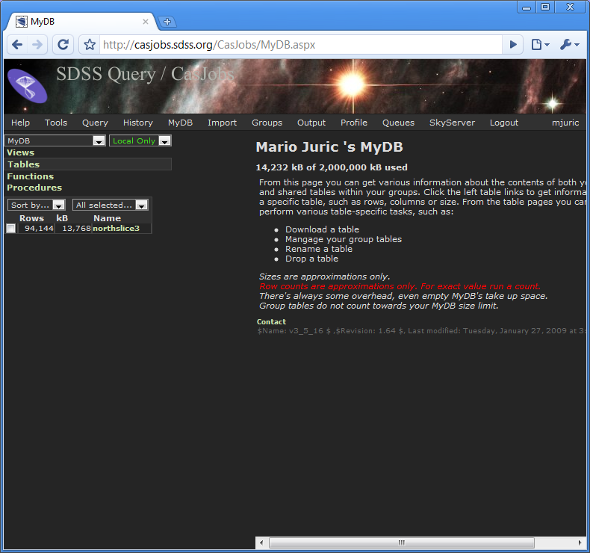

Slide 54
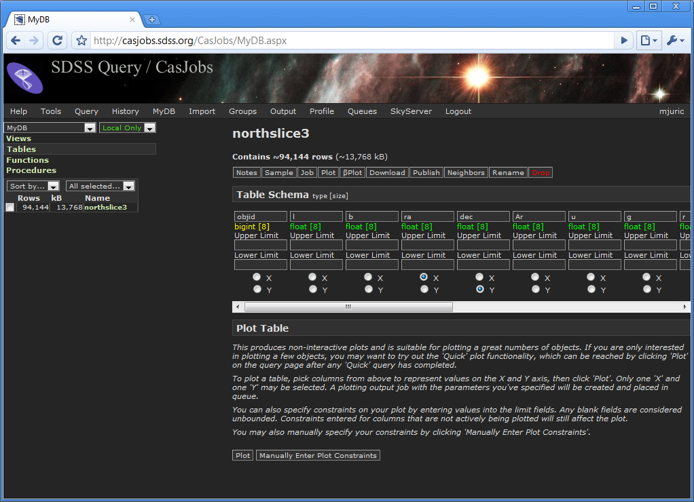

Slide 55
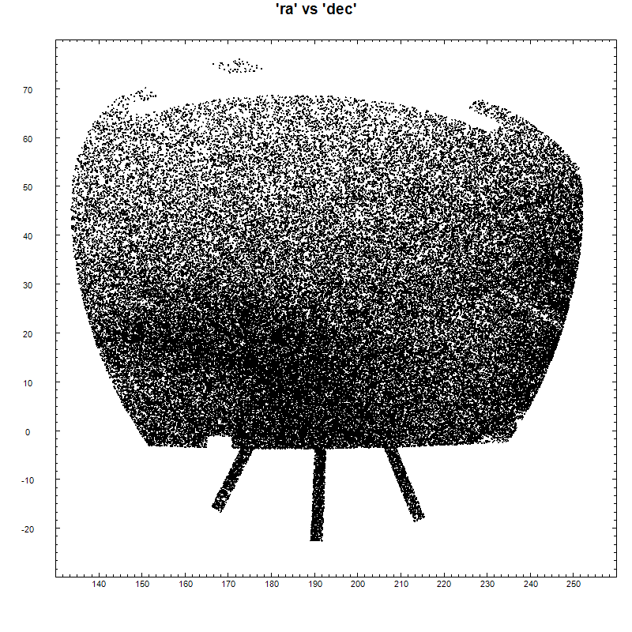

Slide 56
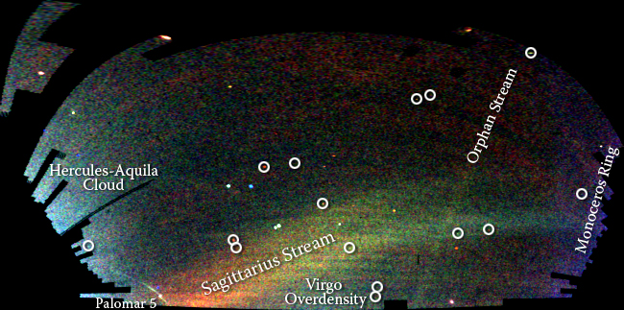
Field of Streams
Credit: Vasily Belokurov and the SDSS
R. A.
Declination

Slide 57
Sagittarius stream
Orphan Stream (Belokurov et al. 2006)
Palomar 5
Virgo Overdensity (Juric et al. 2005, 2008)

Slide 58
Let’s summarize what we just did:
In less than 10 minutes, we “observed” two fields 120deg apart (~4 months), to 22nd magnitude, in 5 bands
We “reduced” and extinction-corrected the data (~70,000 stars/field) and analyzed it using color-magnitude plots
We discovered a main sequence feature in one of the streams at distance around 11.5kpc, likely metal poor
We then proceeded to discover three more streams over the whole sky
10 years ago, this would have been a multi-night observing proposal for top telescopes in the world. The challenge is obtaining the data.
Today it’s an SQL query – the data is already there, the challenge is to ask the right question!

Slide 59
Astronomy in the Age of Large Surveys
Traditionally, astronomy was a data-starved science. Our approach to research and our analysis methods were shaped by this environment. Surveys are altering it; data is becoming abundant and of unprecedented quality.

Slide 60
Sloan Digital Sky Survey
2.5m telescope >10000 deg² 0.1” astrometry r<22.5 flux limit
5 band, 2%, photometry for >50M stars
>300k R=2000 stellar spectra
10 years of ops: ~10 TB of imaging

Slide 61
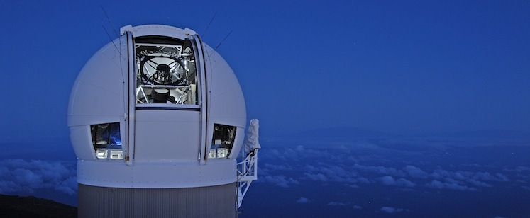
Panoramic Survey Telescope and Rapid Response System
1.8m telescope 30000 deg² 50mas astrometry r<23 flux limit
5 band, better than 1% photometry (goal)
SDSS DR6 Imaging Sky Coverage (Adelman-McCarthy et al. 2008)
~700 GB/night

Slide 62
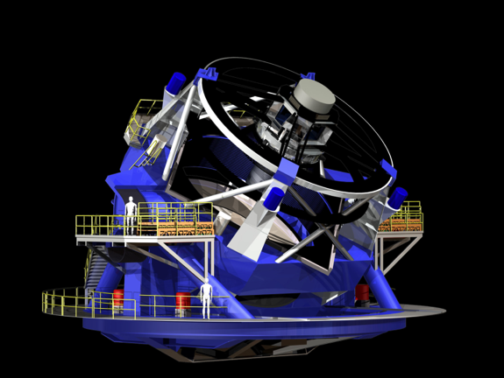
LSST: A Deep, Wide, Fast, Optical Sky Survey
8.4m telescope 18000+ deg² 10mas astrom. r<24.5 (<27.5@10yr)
ugrizy 0.5-1% photometry
3.2Gpix camera 30sec exp/4sec rd 15TB/night 37 B objects
Imaging the visible sky, once every 3 days, for 10 years (825 revisits)

Slide 63
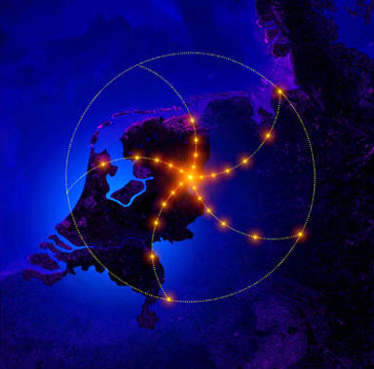
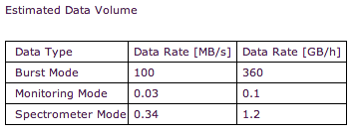
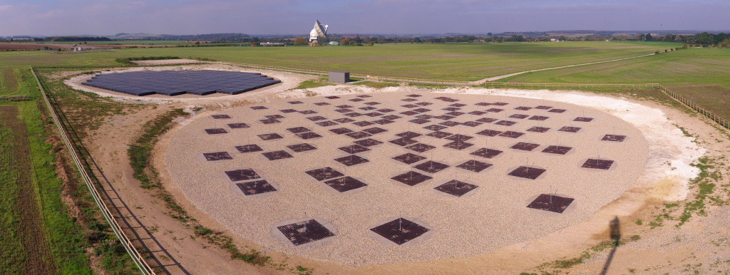
Low-Frequency Array for Radio Astronomy (LOFAR)
Notes:
http://www.lofar.org/astronomy/solar-ksp/technical-description/technical-description

Slide 64
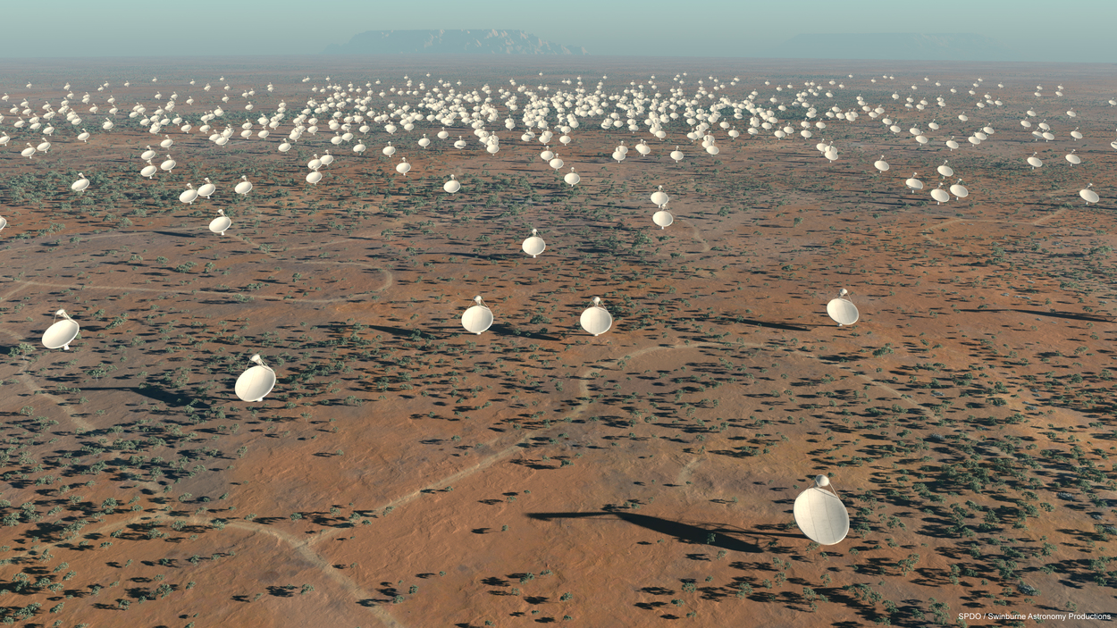
Square Kilometer Array
10 PB / hour
Notes:
http://en.wikipedia.org/wiki/Exabyte

Slide 65
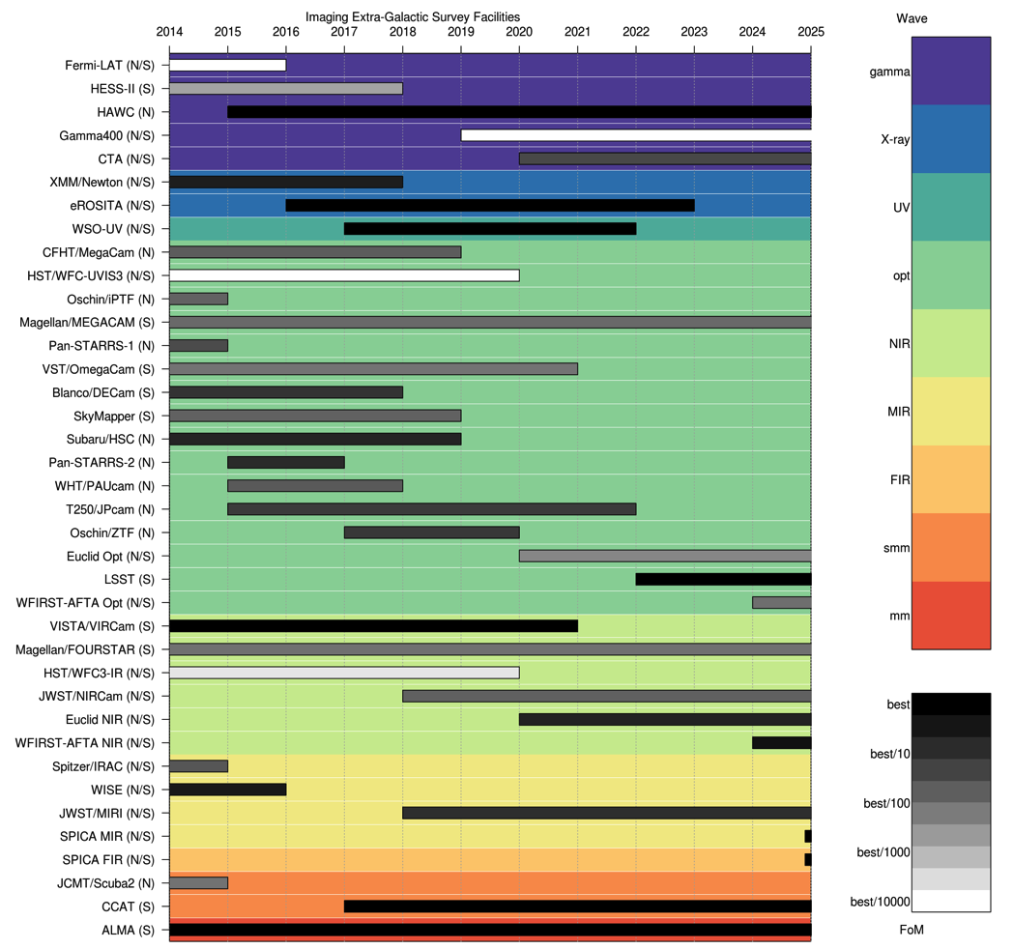
https://asgr.shinyapps.io/ganttshiny/

Slide 66
Astronomy in the Age of Large Surveys
Traditionally, astronomy was a data-starved science. Our approach to research and our analysis methods were shaped by this environment. Surveys are altering it; data is becoming abundant and of unprecedented quality.
For optical, LSST will cap this transformation: it will deliver the positions, magnitudes and variability information for virtually everything in the southern sky to 24th-27th magnitude, with an order of magnitude better controlled systematics than current surveys.

Slide 67
A Quantitative Difference
Final Image Collection – All DRs | 515 PB | All Data Releases Includes Virtual Data (475 PB)
Final Image Collection – DR11 | 114 PB | Data Release 11 (Year 10) Includes DR11 Virtual Data (88 PB) and all raw images from all years
Final Database | 16 PB | Data Release 11 (Year 10) Includes Data, Indexes, and DB Swap
Final Disk Storage | 375 PB | Archive and Base Sites
Final Tape Storage | 121 PB | Single Site, Single Copy Only
Peak Number of Nodes | 1750 | Archive and Base Sites Compute and Database Nodes
Number of Alerts Generated | 28 billion | Life of survey
Virtual Data is data that is dynamically recreated on-demand from provenance information
Notes:
Final Image Archive – All DRs
non-virtual: LDM-141 imgData!C48+I48 raw plus raw calibration
non-virtual: LDM-141 imgData!M48 minus the above (raw) number
virtual: LDM-141 imgData!AE16
Final Image Collection – DR11 Only
non-virtual: LDM-141 imgData!D48+I48 raw plus raw calibration
non-virtual: LDM-141 imgData! row 48
virtual: LDM-141 imgData!AE16-AE15
Final Database
LDM-141 dbL2: dbL2!V117
Final Disk Storage
PB: LDM-144: use SiteProfile
Final Tape Storage
PB: LDM-144: SiteProfile!AY38
Number of Nodes
LDM-144: use SiteProfile
Number of Alerts Generated
LDM-141: sciReq!G72 * sciReq!G93 (avg alert per visit * num visits)

Slide 68
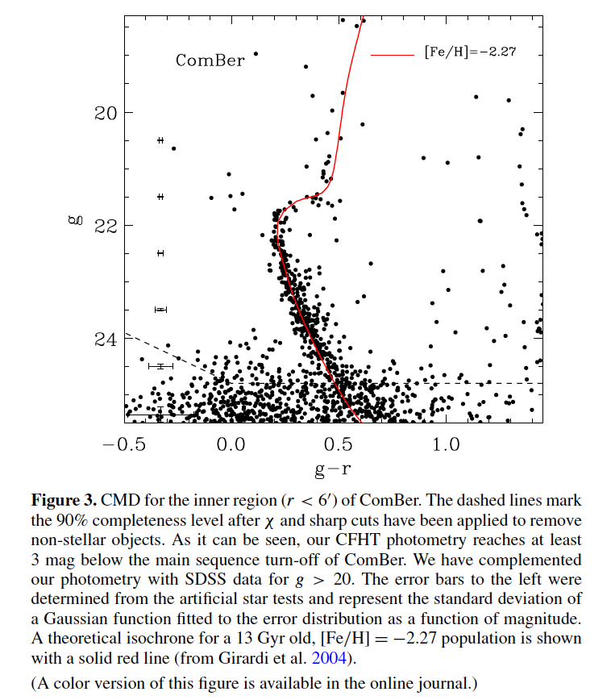
A Qualitative Difference
9 hours on CFHT/MegaCam (Munoz et al. 2010)
LSST, single-epoch and full-survey (simulation)

Slide 69
Astronomy in the Age of Large Surveys
Traditionally, astronomy was a data-starved science. Our approach to research and our analysis methods were shaped by this environment. Surveys are altering it; data is becoming abundant and of unprecedented quality.
For optical, LSST will cap this transformation: it will deliver the positions, magnitudes and variability information for virtually everything in the southern sky to 24th-27th magnitude, with an order of magnitude better controlled systematics than current surveys.
We’re entering the age of abundance of high quality data. Success in research will depend on the ability to analyze and mine knowledge from that data.

Slide 70
Next time …
Software Tools
Python
IPython
Git and github
Basic numerical and analysis libraries

